Slide 1
Barber & Salon Booking App
CISC3026 Software Engineering Principle (Group Number 7)
Un Weng Hou (DC026718) | Lao Chi Ian (DB926205)
Wong Kai Yuan (DC026157) | Ieong Un San (DC028721)

Slide 2
Table of contents
01
Introduction
03
Design Model
02
Requirement Model
04
Test Specification
CISC3026 Software Engineering Principle (Group Number 7)
Class Diagram | Sequence Diagram
State Diagram | Activity Diagram
List of requirement
Use Case model
For functional requirement
For non-functional requirement

Slide 3
01
Introduction
Barber & Salon Booking App

Slide 4
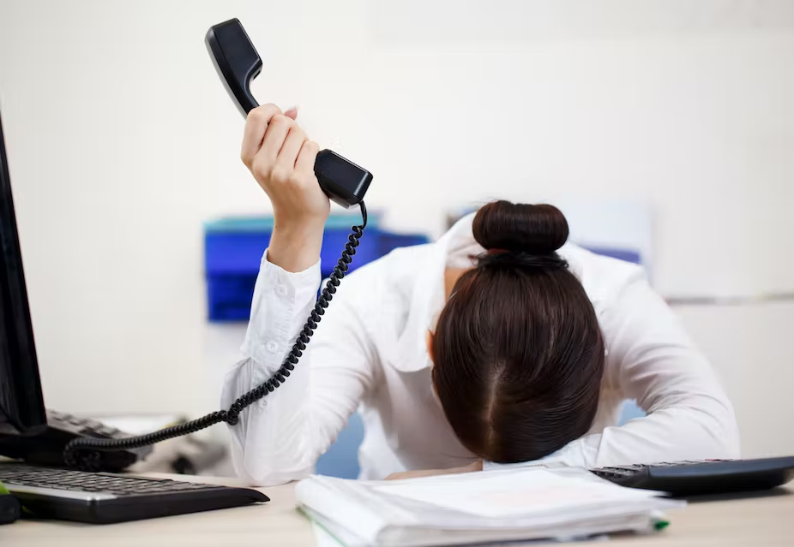
Introduction
THE CONCEPT
Inconvenient
Insufficient
Easy to cause Confusion
In Macau, appointments for barber and salon are usually made by phone calls or some messaging app such as wechat.

Slide 5
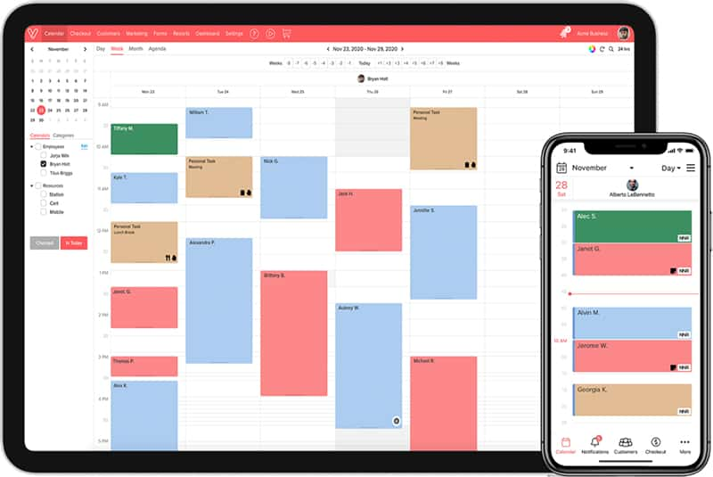
The Idea?
Online Booking System
Show Schedule
That include all barber shops and salons in Macau.
Schedule and available time for each stylist will be included
Advertisement
Product Store
Despite being red, Mars is a cold place
Act as hair & beauty product store at the same time.

Slide 6
02
Requirement Model
Barber & Salon Booking App

Slide 7
Functional Requirement
PPT will only cover brief idea, details can refer report
Functional requirements define the functions of a software, and are also the functions and services that a system needs to provide. The functional requirements of the software are below.

Slide 8
(1) Functional requirement
(1) Associate every online booking with an account
(2) Enable users to search for the shop according to their selection
(3) Enable users to select different services provided by the shop
(4) Accept users to check available date and time of the stylist
(5) Booking confirmation should be sent to the specified contact details

Slide 9
(2) Functional requirement
(6) Calculate and display total amount that users need to pay
(7) Cancel bookings
(11) Comment and grading
(8) Advertisement
(12) One user can only have one account
(9) Product Attributes
(10) Online Payment

Slide 10
Non- Functional Requirement
PPT will only cover brief idea, details can refer report
Non-functional requirements refer to those requirements that are not directly related to the specific functions of the system, but they are related to the overall characteristics of the system, such as reliability, response time, storage space, etc. The non-functional requirements of the software are below.

Slide 11
(1) Non- Functional requirement
(1) Use captcha and encryption to avoid bots from booking
(2) Performance,Usability
(3) Maintainability

Slide 12
Use Case Model
PPT will only cover brief idea, details can refer report
A use case diagram is the simplest representation of the interaction between the user and the system, showing the relationship between the user and his related use cases. Through the use case diagram, people can understand the different types of users and use cases of the system. Use case diagrams are also often used in conjunction with other diagrams.

Slide 13
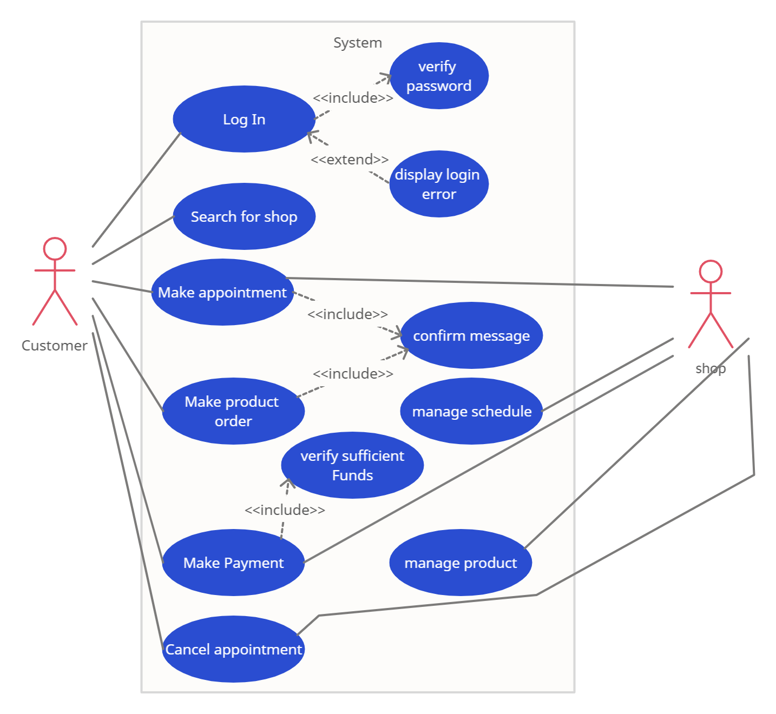
Use case model

Slide 14
03
Design Model
Barber & Salon Booking App

Slide 15
Class Diagram
Static System Model :

Slide 16
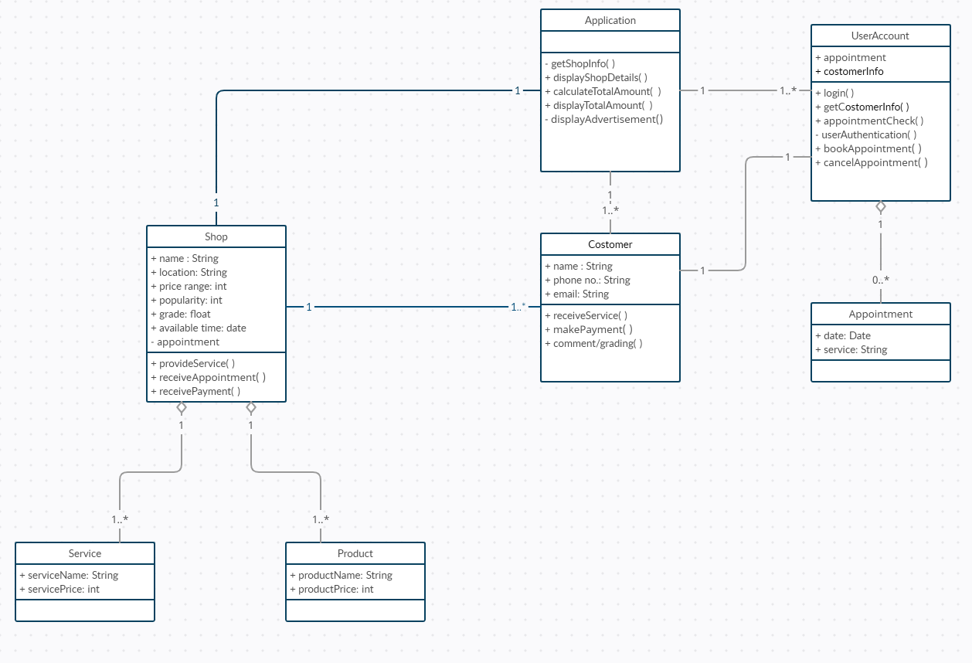
Class Diagram
Diagram that depicts system's classes
Classes
Properties
Operations
Relationships

Slide 19
Sequence Diagram
Dynamic System Model :

Slide 20
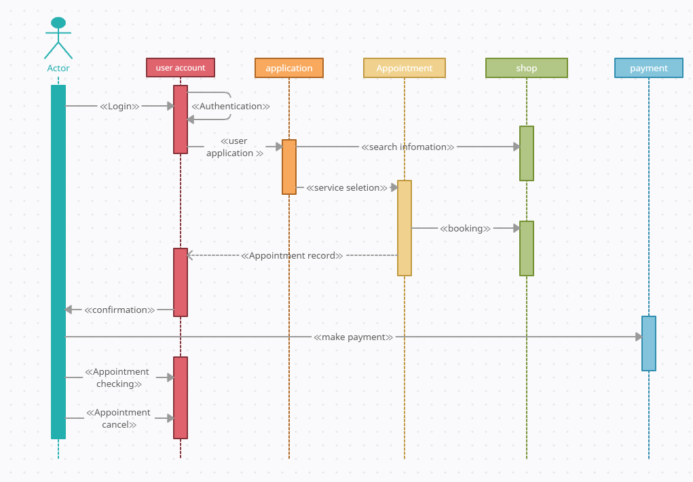
Sequence Diagram
diagram that depicts system's process in time sequence
Actors
Messages
Loop or iteration area

Slide 22
Activity Diagram
Dynamic System Model :

Slide 23
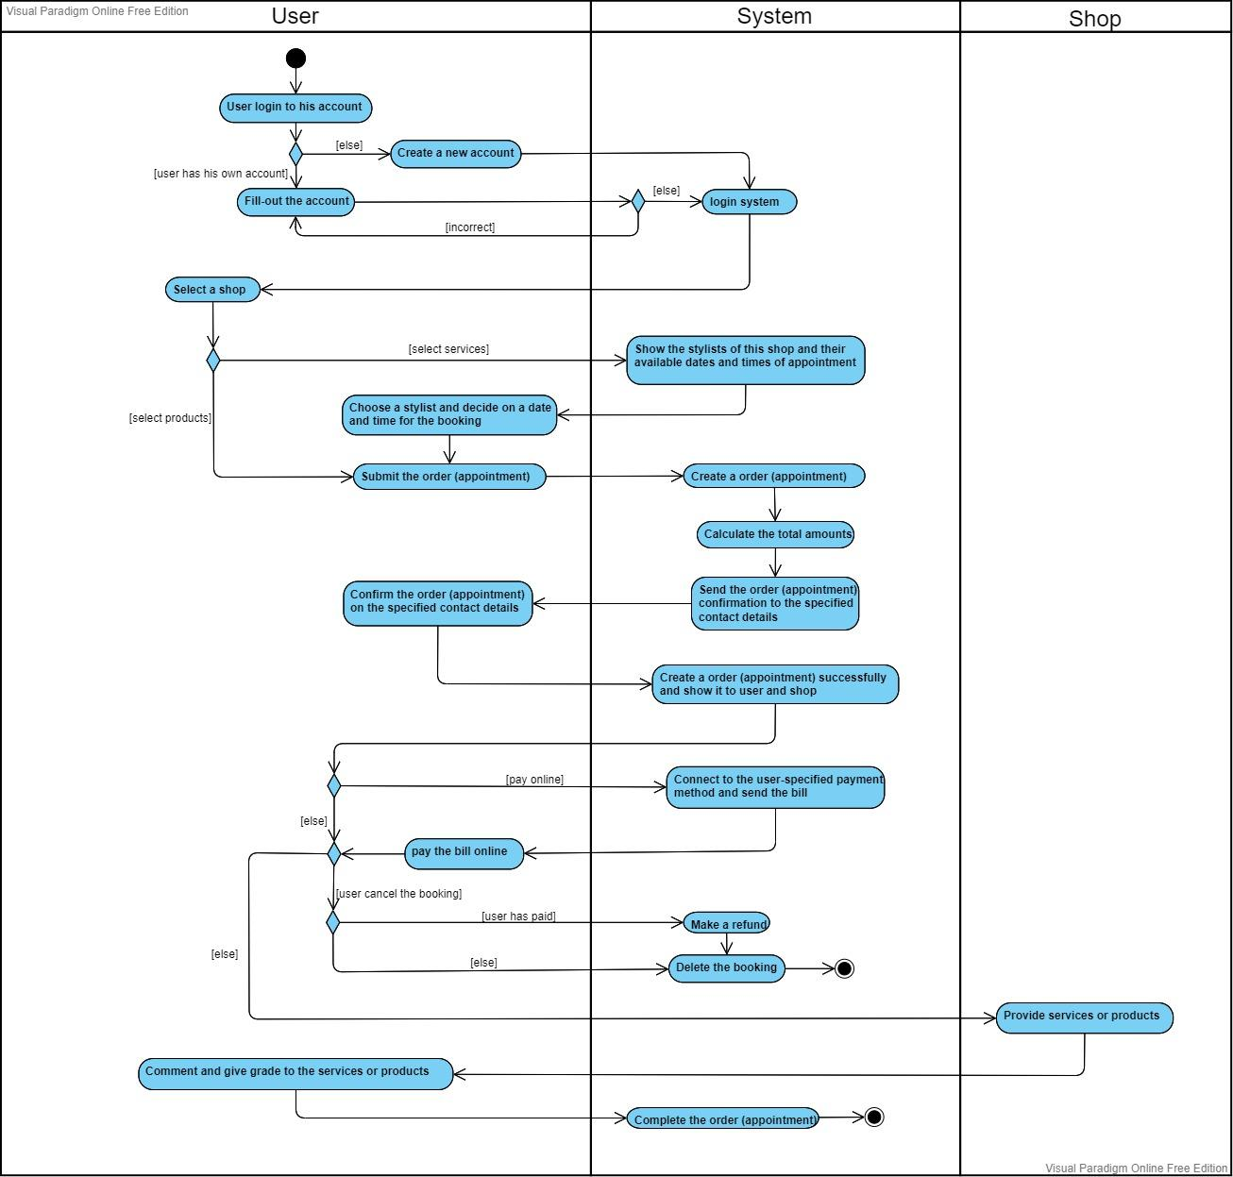
Partition
User
System
Shop

Slide 27
State Diagram
Dynamic System Model :

Slide 28
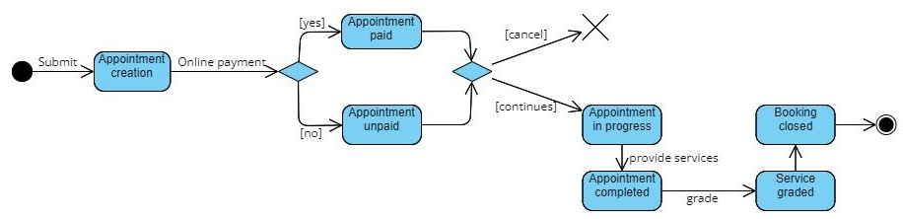
The state diagram of appointment

Slide 29
04
Test Specification
Barber & Salon Booking App

Slide 30
Test Specification
PPT will only cover brief idea, details can refer report
A test case in software engineering is a description of the inputs, execution conditions, testing process, and anticipated results that define a single test to be executed to achieve a specific software testing objective.

Slide 31
We will include “Input”, “Test” and “Output” for each functional & non-functional requirements. If some cannot be defined, then it will not be included.

Slide 32
Test Specification of Functional Requirement
12

Slide 33
(1) Associate every booking with an account
Input
Tests
Output
Online Booking ID
User account details
Test for input where user account has detailed information
Test for input where user account has no information
Test for input where there is no user account (customer visit apps as guest)
OK or Error message indicating that online booking is not associated with an suitable account.

Slide 34
(2) One user can only have one account
Input
Tests
Output
User Account
Phone number details
Test for input where 1 user account with 1 unique phone number
Test for input where 1 user account with multiple phone numbers
Test for input where multiple accounts with 1 same phone number
OK or Error message indicating that one user has more than one account.

Slide 35
(3) Enable users to search for the shop according to their selection
Input
Tests
Output
Selections by location, price, popularity, grade, fastest available for appointment
Test for input where all field is empty
Test for input where all field has valid data
Test for input where all field has invalid data
Test for input where the “location” field has valid data.
Test for input where the “location” field has an invalid data.
Test for input where the “price” field has valid data.
Test for input where the “price” field has an invalid data.
Test for input where the “popularity” field has valid data.
Test for input where the “popularity” field has an invalid data.
Test for input where the “grade” field has valid data.
Test for input where the “grade” field has an invalid data.
Test for input where the “fastest available for appointment” field has valid data.
Test for input where the “fastest available for appointment” field has an invalid data.
List of desired search result or error message indicating that search is not successful.

Slide 36
(4) Enable users to select different services provided by the shop
Input
Tests
Output
Shop Details
Test for input where services are provided by shop
Test for input where services are not provided by shop
Test for input where all services are chosen
Test for input where multiple services are chosen
Test for input where only one service is chosen
Test for input where no service is chosen
OK or error message indicating that services provided by the shop cannot be chosen.

Slide 37
(5) Accept users to check available date and time of the stylist
Input
Tests
Output
Stylish Timeline
Test for input where available date and available time is chosen
Test for input where available date but not available time is chosen
Test for input where not available date but available time is chosen
Test for input where not available date and not available time is chosen
Test for input where past date is chosen
Test for input where far future is chosen (like after 10 years)
Test for input where no date is chosen but available time is chosen
Test for input where available date is chosen but no time is chosen
Test for input where no date and time is chosen
Verify that the user can not select or is not permitted to select time that are already booked or not allowed for booking.
OK or error message indicating that date and time is not applicable

Slide 38
(6) Booking confirmation should be sent to the specified contact details
Input
Tests
Output
Booking ID
Contact Details
Verify that booking confirmation is successfully generated.
Test to send booking confirmation where no contact details within booking ID
Test to send booking confirmation where phone contact is set as contact details.
Test to send booking confirmation where email is set as contact details.
Test to send booking confirmation where wechat (or other software) is set as contact details.
Check once the booking is confirmed, the stylist timetable is filled
OK or error message indicating that booking confirmation is not sent to the user.

Slide 39
(7) Calculate and display total amount that users need to pay
Input
Tests
Output
Product / Service Selected
Test for input that the service or product selected by customer is correctly calculated
Test for input that the service or product selected by customer is correctly displayed
Test for input that the service or product selected by customer is incorrectly calculated
Test for input that the service or product selected by customer is incorrectly displayed
Check if the user can Amend an existing order by adding an additional feature or comment to seller / service provider
Price to be paid or error message indicating that calculation of total amount is not successful

Slide 40
(8) Cancel bookings
Input
Tests
Output
Booking ID
User details
Check on canceling the bookings the system does not refund the money. (If there are any such conditions applied)
Check on canceling the booking the system refunds money to the same way from which the account amount is paid.
Verify that after cancellation the seat’s status is updated to available.
Test for cancel a booking that doesn’t exist
Test for cancel a booking that was canceled before
Test for cancel a booking that was already past
OK or error message indicating that canceling attempt cannot be made

Slide 41
(9) Advertisement
Input
Tests
Output
None
Verify the maximum limit of advertisement that a page can have, having more advertisements than permitted results in error messages.
Test when there is no advertisement
Test when there is advertisement
None

Slide 42
(10) Product Attributes
Input
Tests
Output
Product ID with attributes (characteristics, price, size, quantity, source)
Test for product attributes that are all filled
Test for product attributes that are all empty
Test for product attributes that are negative in quantity.
Verify that the pricing of different types of attributes is displayed to the users.
Verify that the user should see real-time stock number of product.
Verify that users can successfully select single or more than one attribute.
OK or error message indicating that product attributes need to be further revised.

Slide 43
(11) Online Payment
Input
Tests
Output
Payment amount
Product list
Payment method
Test for input where payment that are failed
Test for input where payment that are successful
Verify that all the different types of payment methods work fine.
Check for previous billing amount is paid
Check if the user able to check the receipt and download it
Verify that after successful payment the user selected time is updated to booked.
Receipt of order or error message indicating that payment is not successful

Slide 44
(12) Comment and grading
Input
Tests
Output
Customer details
Comment
Grading
Test for input where no grade is being input
Test for input where maximum grade is being input
Test for input where grade between 0 – max is being input
Test for input where no comments is being input
Test for input where lengthy comments is being input
Verify that only customer that have used the service is allowed to give comment and grade.
OK or error message indicating that comment and grading is not valid.

Slide 45
Test Specification of non- Functional Requirement
03

Slide 46
Use captcha and encryption to avoid bots from booking
Tests
Output
Test for correctly input for captcha
Test for incorrectly input for captcha
Test for many attempts on input for captcha
OK or error message indicating that unable to avoid bots

Slide 47
(2) Performance, Usability
Tests
Output
Application load time should not be more than 5 secs up to 1000 users accessing it simultaneously
Software should be installable on all versions of IOS and Android
User should be able to use app after short introduction / tutorial when first got into apps
Response time of each page should be less than 1 second
OK or error message indicating that performance does not achieve pre defined metrics.

Slide 48
(3) Maintainability
Tests
Output
Time to make changes on system should be less than time needed to restart the whole project
Cost to make changes on system should be less than time needed to restart the whole project
Test on different architecture to check which has the most efficient and least complexity.
None

Slide 49
05
Conclusion
Barber & Salon Booking App

Slide 50
Our location : Macau
Limitation
Strength
Small Town
High efficiency
Limited Market
Low Cost

Slide 51
Our expectation
Save Time
Exposure Platform
Increase convenience
Contribute to entire hairdressing industry
Customer : direct booking via apps
Stylist : prepare earlier accordingly to timetable
Able to help expanding the customer base
Able to see how is the service via grading
Buy product directly
By having an overall apps, be able to contribute to the hairdressing industry

Slide 52
Thanks!
Does anyone have any questions?
Please keep this slide as attribution

